Slide 1
GRADE 7 ACCELERATED · UNIT 6 · LESSON 5
Distance on the Coordinate Plane
MA.8.GR.1.2
I can find the distance between two points: subtract on a line, and draw the right triangle when the segment is slanted.
Grade 7 Accelerated · Unit 6 · Lesson 5 — Distance on the Coordinate Plane
1

Slide 2


Warm-Up
1. A 25-ft ladder reaches 20 ft up a wall. How far out is its foot?
2. Do sides of 12, 35 and 37 make a right triangle?
3. A map's scale is 1 cm : 5 km. Towns 3.4 cm apart are how far?
4. How far apart are
and
?
Grade 7 Accelerated · Unit 6 · Lesson 5 — Distance on the Coordinate Plane
2

Slide 3
Warm-Up
1. A 25-ft ladder reaches 20 ft up a wall. How far out is its foot?
15 ft
2. Do sides of 12, 35 and 37 make a right triangle?
Yes — 144 + 1,225 = 1,369 = 37²
3. A map's scale is 1 cm : 5 km. Towns 3.4 cm apart are how far?
17 km
4. How far apart are
and
?
8
Grade 7 Accelerated · Unit 6 · Lesson 5 — Distance on the Coordinate Plane
3

Slide 4
Vocabulary
horizontal distance
between two points with the same y: the difference of the x's
vertical distance
between two points with the same x: the difference of the y's
legs on the grid
the horizontal and vertical segments under a slanted one; the slanted segment is the hypotenuse
Grade 7 Accelerated · Unit 6 · Lesson 5 — Distance on the Coordinate Plane
4

Slide 5
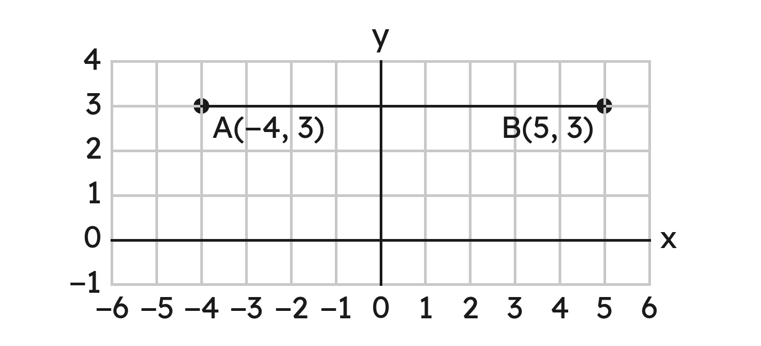
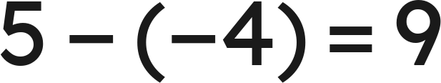
Notes
I. On one line: subtract — and across zero, add
Same y: subtract the x's. Same x: subtract the y's.
: across zero, 4 and 5 add.
Grade 7 Accelerated · Unit 6 · Lesson 5 — Distance on the Coordinate Plane
5

Slide 6
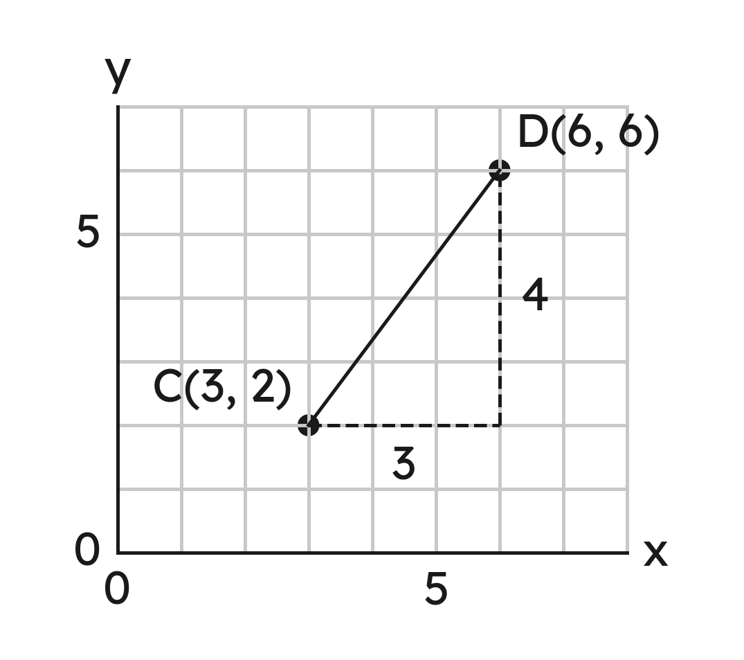


Notes
II. Slanted: draw the right triangle
,
The legs are the across and the up. The distance is the hypotenuse.
Grade 7 Accelerated · Unit 6 · Lesson 5 — Distance on the Coordinate Plane
6

Slide 7
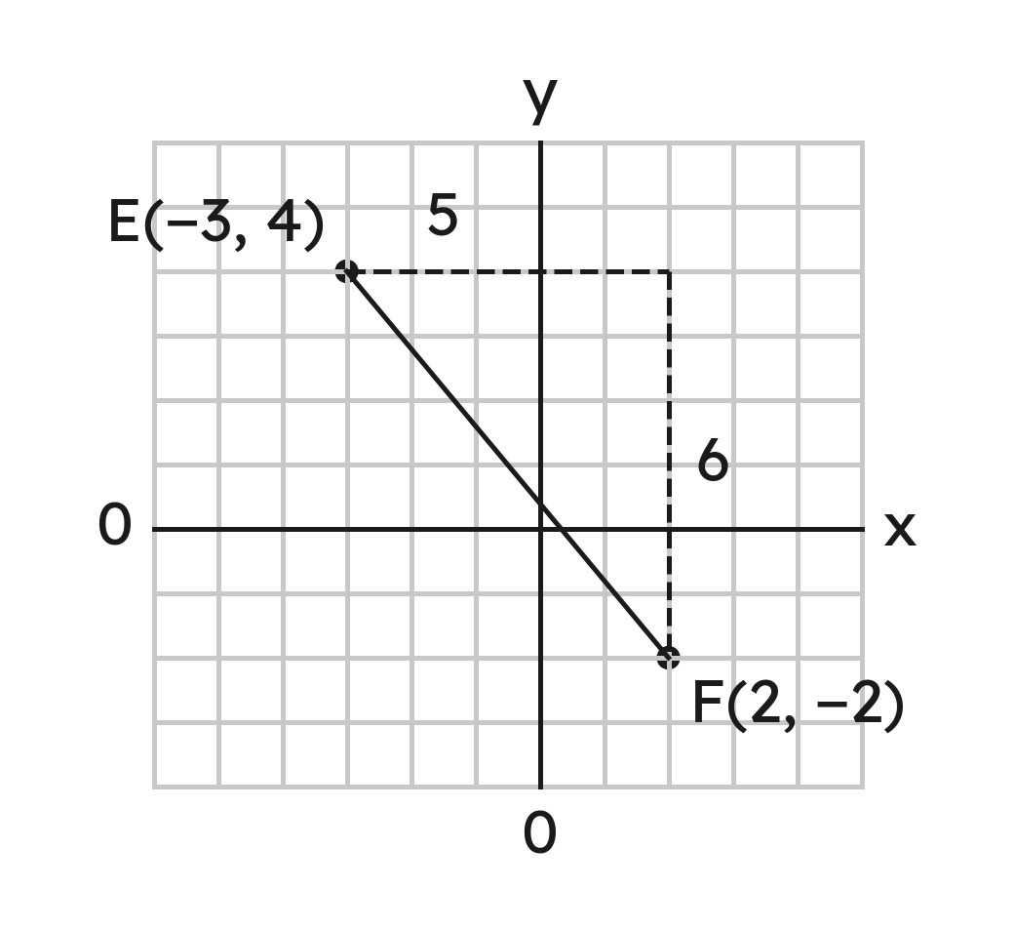
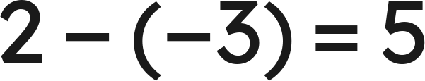
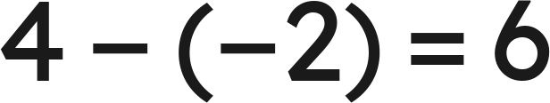

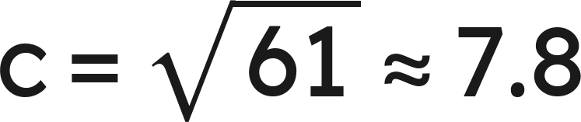
Notes
III. The legs come from the coordinates
across
down
,
Grade 7 Accelerated · Unit 6 · Lesson 5 — Distance on the Coordinate Plane
7

Slide 8


Example 1
Find the distance between
and
.
Grade 7 Accelerated · Unit 6 · Lesson 5 — Distance on the Coordinate Plane
8

Slide 9
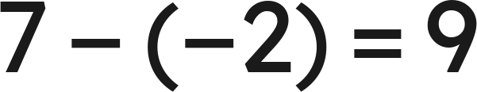

Example 1
Answer: 9 units
Grade 7 Accelerated · Unit 6 · Lesson 5 — Distance on the Coordinate Plane
9

Slide 10


Your Turn
Find the distance between
and
.
Grade 7 Accelerated · Unit 6 · Lesson 5 — Distance on the Coordinate Plane
10

Slide 11




Your Turn
Find the distance between
and
.
check:
Answer: 11 units
Grade 7 Accelerated · Unit 6 · Lesson 5 — Distance on the Coordinate Plane
11

Slide 12


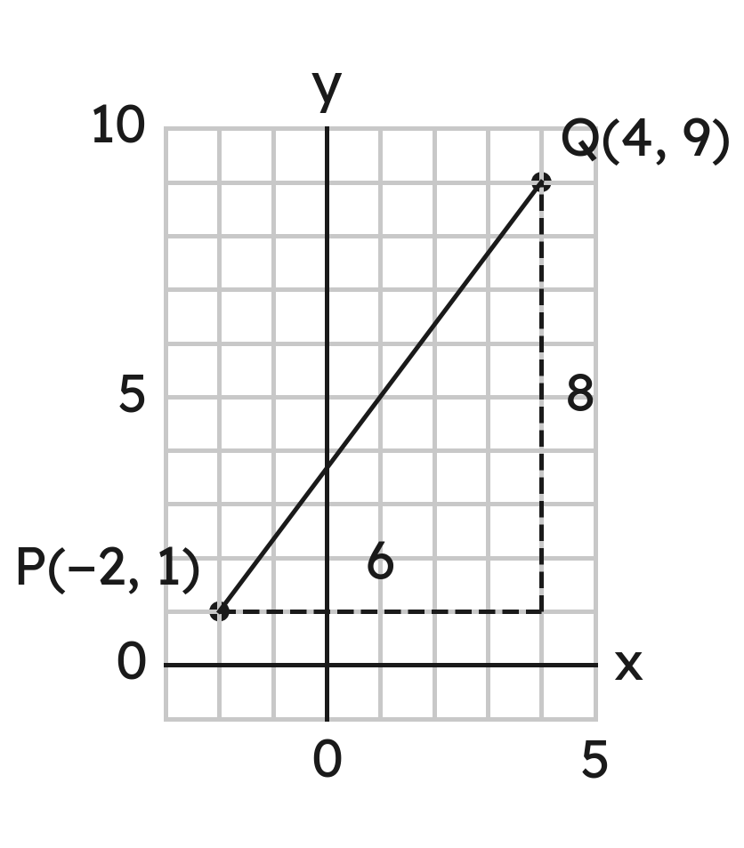
Example 2
Find the distance between
and
.
Grade 7 Accelerated · Unit 6 · Lesson 5 — Distance on the Coordinate Plane
12

Slide 13

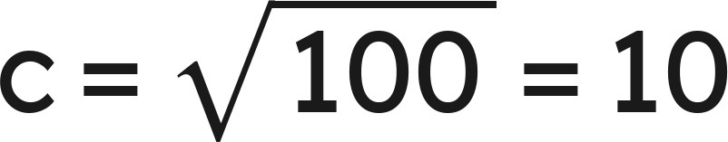
Example 2
Answer: 10 units
Grade 7 Accelerated · Unit 6 · Lesson 5 — Distance on the Coordinate Plane
13

Slide 14


Your Turn
Find the distance between
and
, to the nearest tenth.
Grade 7 Accelerated · Unit 6 · Lesson 5 — Distance on the Coordinate Plane
14

Slide 15


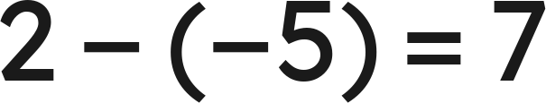
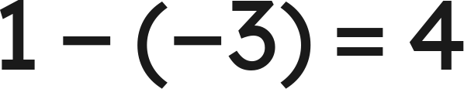


Your Turn
Find the distance between
and
, to the nearest tenth.
across
, up
,
Answer: √65 ≈ 8.1 units
Grade 7 Accelerated · Unit 6 · Lesson 5 — Distance on the Coordinate Plane
15

Slide 16


Whiteboards · Question 1 of 9
How far apart are
and
?
Answer it.
Grade 7 Accelerated · Unit 6 · Lesson 5 — Distance on the Coordinate Plane
16

Slide 17



Whiteboards · Question 1 of 9
How far apart are
and
?
Answer: 10 units
Grade 7 Accelerated · Unit 6 · Lesson 5 — Distance on the Coordinate Plane
17

Slide 18


Whiteboards · Question 2 of 9
How far apart are
and
?
Answer it.
Grade 7 Accelerated · Unit 6 · Lesson 5 — Distance on the Coordinate Plane
18

Slide 19


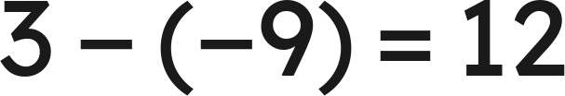
Whiteboards · Question 2 of 9
How far apart are
and
?
Answer: 12 units
Grade 7 Accelerated · Unit 6 · Lesson 5 — Distance on the Coordinate Plane
19

Slide 20


Whiteboards · Question 3 of 9
What is the distance between
and
?
A. 9
B. 8
C. 2
D. −8
Answer it.
Grade 7 Accelerated · Unit 6 · Lesson 5 — Distance on the Coordinate Plane
20

Slide 21


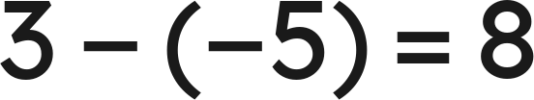
Whiteboards · Question 3 of 9
What is the distance between
and
?
Answer: B — 8 units
Grade 7 Accelerated · Unit 6 · Lesson 5 — Distance on the Coordinate Plane
21

Slide 22


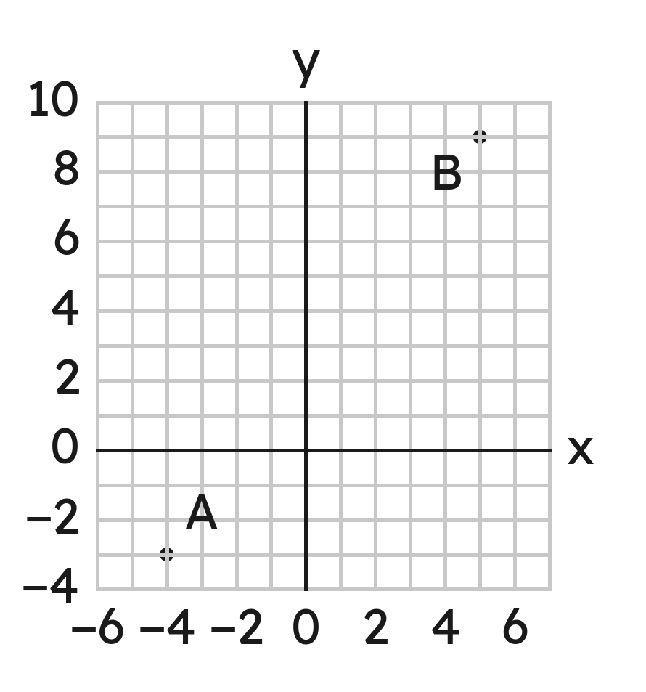
Whiteboards · Question 4 of 9
How far apart are
and
?
Answer it.
Grade 7 Accelerated · Unit 6 · Lesson 5 — Distance on the Coordinate Plane
22

Slide 23




Whiteboards · Question 4 of 9
How far apart are
and
?
across 9, up 12
Answer: 15 units
Grade 7 Accelerated · Unit 6 · Lesson 5 — Distance on the Coordinate Plane
23

Slide 24


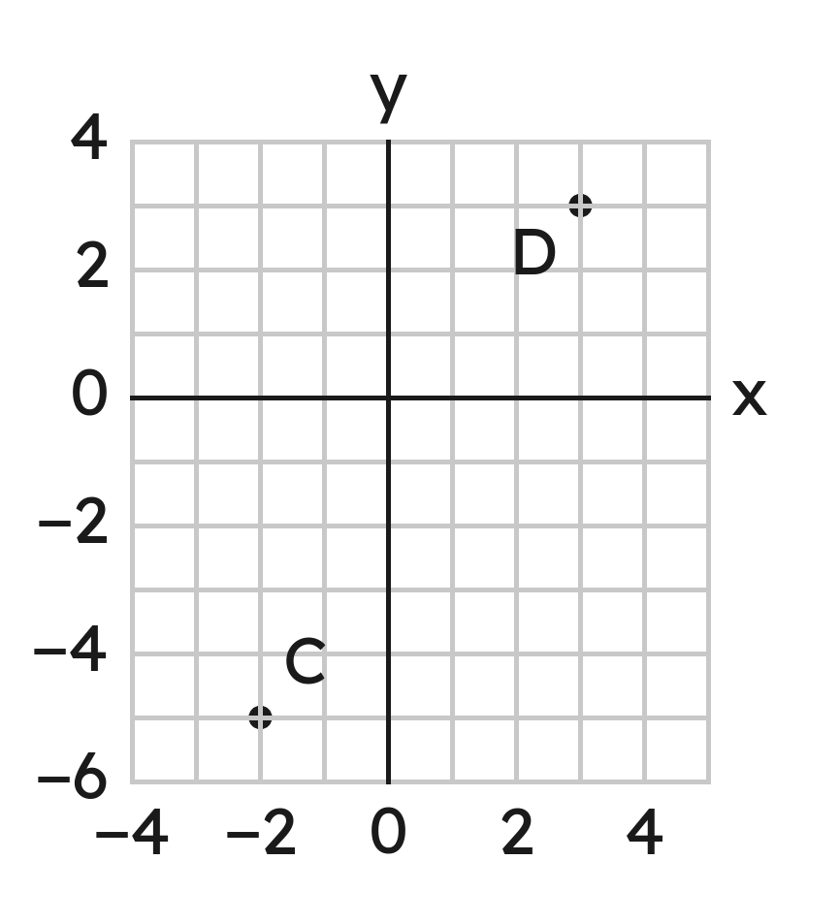
Whiteboards · Question 5 of 9
How far apart are
and
, to the nearest tenth?
Answer it.
Grade 7 Accelerated · Unit 6 · Lesson 5 — Distance on the Coordinate Plane
24

Slide 25



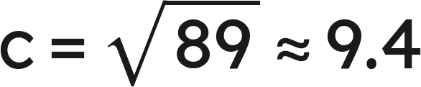
Whiteboards · Question 5 of 9
How far apart are
and
, to the nearest tenth?
across 5, up 8
Answer: √89 ≈ 9.4 units
Grade 7 Accelerated · Unit 6 · Lesson 5 — Distance on the Coordinate Plane
25

Slide 26


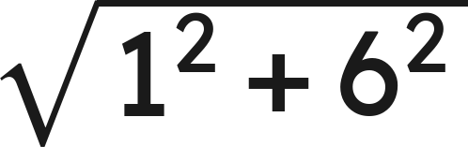
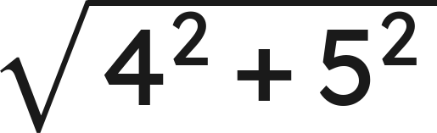
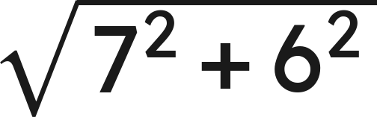

Whiteboards · Question 6 of 9
Which gives the distance between
and
?
A.
B.
C.
D.
Answer it.
Grade 7 Accelerated · Unit 6 · Lesson 5 — Distance on the Coordinate Plane
26

Slide 27


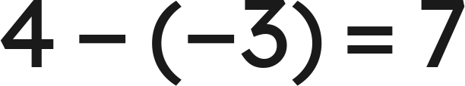
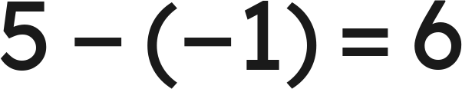

Whiteboards · Question 6 of 9
Which gives the distance between
and
?
across
, up
Answer: C — √(7² + 6²) = √85
Grade 7 Accelerated · Unit 6 · Lesson 5 — Distance on the Coordinate Plane
27

Slide 28

Whiteboards · Question 7 of 9
How far is
from the origin?
Answer it.
Grade 7 Accelerated · Unit 6 · Lesson 5 — Distance on the Coordinate Plane
28

Slide 29





Whiteboards · Question 7 of 9
How far is
from the origin?
across
, down
,
Answer: 13 units
Grade 7 Accelerated · Unit 6 · Lesson 5 — Distance on the Coordinate Plane
29

Slide 30



Whiteboards · Question 8 of 9
On a town map in miles, the school is at
,
the library at
and the town hall at
.
How far is the school from the library?
Answer it.
Grade 7 Accelerated · Unit 6 · Lesson 5 — Distance on the Coordinate Plane
30

Slide 31




Whiteboards · Question 8 of 9
On a town map in miles, the school is at
,
the library at
and the town hall at
.
How far is the school from the library?
Answer: 7 mi
Grade 7 Accelerated · Unit 6 · Lesson 5 — Distance on the Coordinate Plane
31

Slide 32


Whiteboards · Question 9 of 9
Ty says
and
are 4 units apart.
What did he do? What is the distance?
Write your answer in sentences.
Grade 7 Accelerated · Unit 6 · Lesson 5 — Distance on the Coordinate Plane
32

Slide 33




Whiteboards · Question 9 of 9
Ty says
and
are 4 units apart.
What did he do? What is the distance?
check:
Answer: He subtracted 7 − 3. Across zero the pieces add: 10 units.
Grade 7 Accelerated · Unit 6 · Lesson 5 — Distance on the Coordinate Plane
33

Slide 34











Independent Set
1.
Find the distance between
and
.
2.
Find the distance between
and
.
3.
Find the distance between
and
.
4.
Find the distance between
and
, to the nearest tenth.
5.
How far is
from the origin, to the nearest tenth?
6.
On a map in kilometers, a pool is at
and a park at
.
How far apart are they in a straight line?
Grade 7 Accelerated · Unit 6 · Lesson 5 — Distance on the Coordinate Plane
34

Slide 35
IXL
1.
Open IXL and start today's skills.
2.
Work on paper where the question needs work. The answer box does not show it.
3.
Every skill listed is required, to a SmartScore of 67. Due at the start of the next class.
Today's skills — all required
Find the distance between two points on a horizontal or vertical line — L9V
Find the distance between two points — ZBP
Grade 7 Accelerated · Unit 6 · Lesson 5 — Distance on the Coordinate Plane
35

